Slide 1
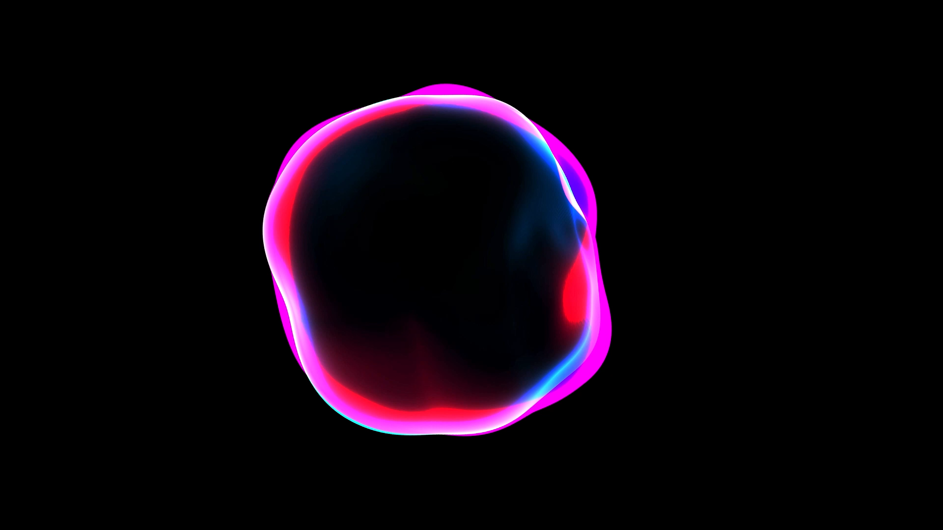
Glaucoma

Slide 2
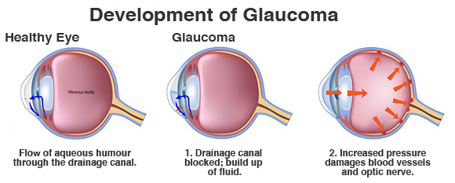
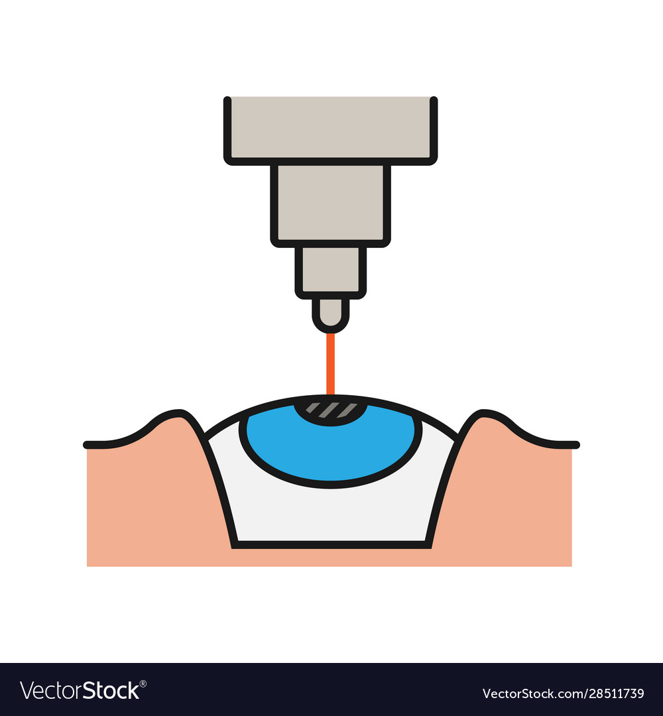

What is glaucoma disease ?
Damage eye’s optic nerve
Cause blindness
Affect people :40-70-year-old
May be asymptomatic
TEMPORARY SOLUTION
Notes:
glaucoma is the most common cause of irreversible blindness.
Glaucoma is a disease that damages your eye’s optic nerve. It usually happens when fluid builds up in the front part of your eye. That extra fluid increases the pressure in your eye, damaging the optic nerve.
This disease affect people from 40 years old to 60 years old.
In many cases, glaucoma may be asymptomatic.
Both laser and conventional surgeries are performed to treat glaucoma. Generally, these operations are a temporary solution, as there is not yet a cure for glaucoma.

Slide 3
Some statistics…
2010
2020
2040
111.8 million
79.6 million
44.7 million
Notes:
As of 2010, there were 44.7 million people in the world with open angle glaucoma.
internationally and in the United States, glaucoma is the second-leading cause of blindness.[
Based on prevalence studies, it is estimated that 79.6 million individuals will have glaucoma in 2020. This number is likely to increase to 111.8 million individuals in 2040.
In the USA, blindness is the third most feared health problem, after cancer and cardiac attacks.

Slide 4
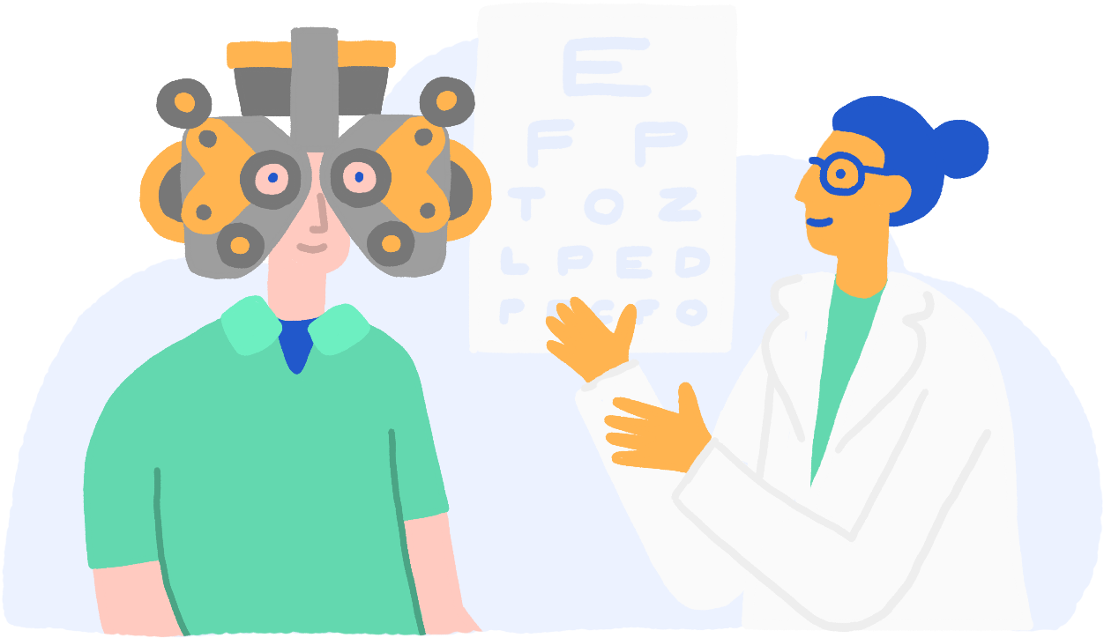
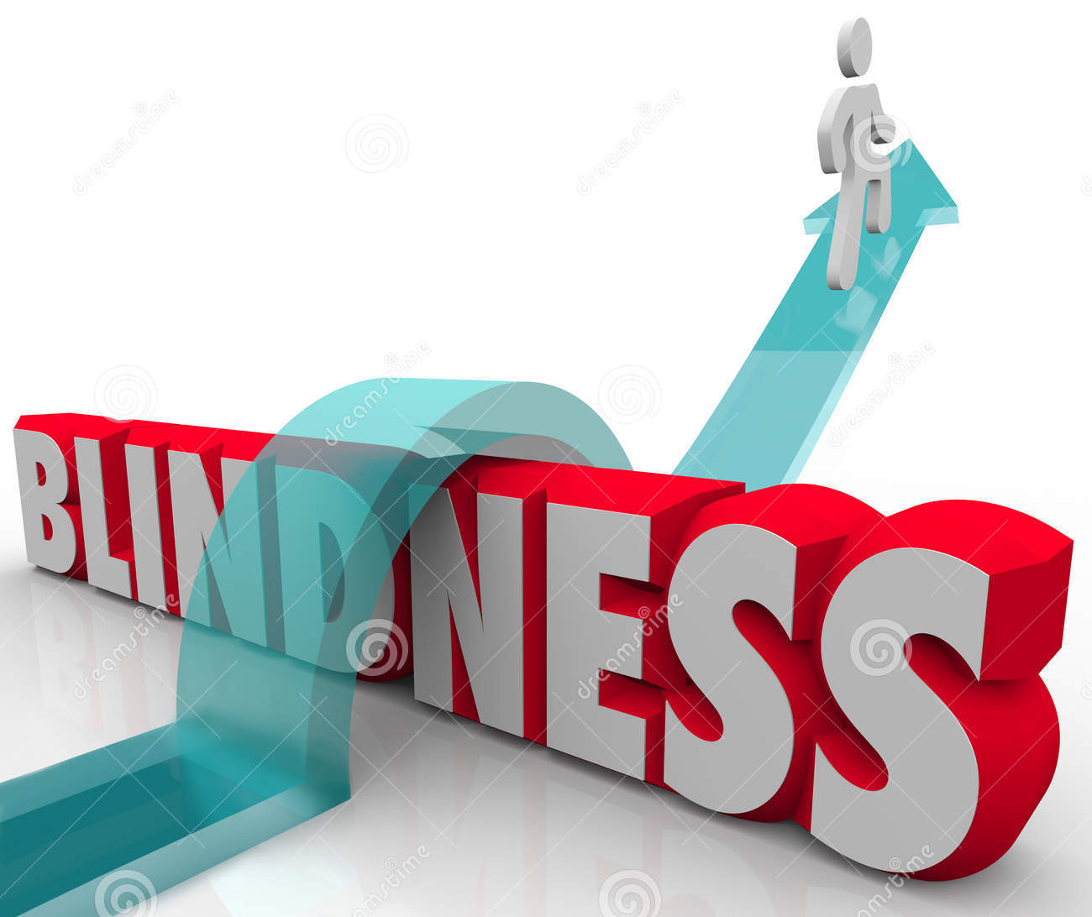
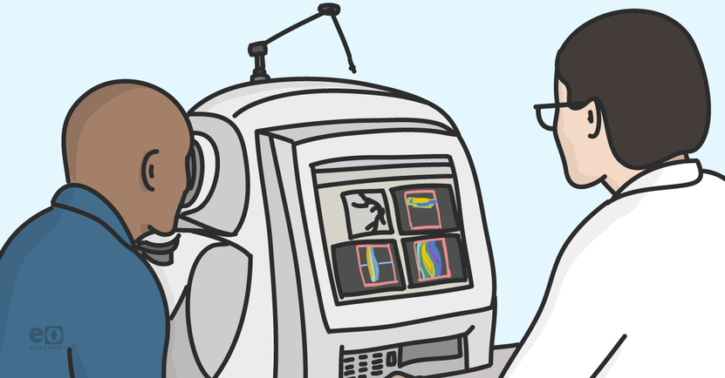
How to prevent ?
Ophthalmologist
appointment
90% of glaucoma is undetected
Only 10% is detected
Once a year
Optical Coherence Tomography Angiography
Notes:
Unfortunately, many individuals are unaware of the existence of glaucoma.
In some developing countries, 90% of glaucoma is undetected.
In most cases, blindness can be prevented with appropriate control and treatment.
A better awareness could prevent visual disability in many people.
How ? With a simple consultation once a year in the ophthalmologist.
The ophtalomogist can detect any abnormal pressure in eyes and can do some specific measurement with the help of
OCT angiography (
Optical Coherence Tomography Angiography
A classification of normal and sick patients can help us to predict if a patient has or could have a glaucoma very fast.

Slide 5
Our data set
Notes:
Our dataset is composed of 63 measurement in the eyes in normal and sick patients (patients with glaucoma).
We selected these dataset because:
No NA
Enough features
We would like to classify the data with KNN firstly.
But before, we need to understand our data and choose features that will help us to classify patients.

Slide 6
EDA
Notes:
For that we performed EDA.
Correlation matrix
PCA
Deletion of features,
PCA again.

Slide 7

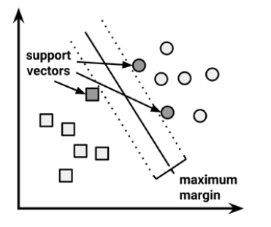
SVM - Support Vector Machine
SVM is well suited to applications with a high number of features
It looks for the hyperplane with the best margin- MMH (maximum margin hyperplane)
Notes:
Our data set has many features, all of them numeric, so we decided to start with the SVM algorithm.
I assume everyone here knows what support vector machine or SVM is because Romi did a really good job of teaching it to us, but I'll go over it a bit just in case. I used Some of the pictures from Romi’s presentation.
What is special about SVM is that instead of looking for what is the most different between the classes, it looks for the things that are most similar in both classes.
The SVM algorithm will search for something from class A that is very similar to class B (for example apples which are yellow and have elliptic form that are similar to lemons), and this will be a support vector (and vice versa). It looks at the individuals that are at the edges, closer to the other group, and then tries to find the best hyperplane that separates the classes.
SVM is based on the idea of finding a hyperplane that best separates the features into different domains.
The hyperplane is a function which is used to differentiate between features.
In 2-D, the function used to classify between features is a line
In 3-D the function used to classify between features is called as a plane
The function which classifies the point in higher dimension is called as a hyperplane.
SVM will always aim for the maximum margin hyperplane (MMH)
One of the first things that need to be done with this algorithm is to choose a kernel.
We didn't know which kernel may work best, so we started with the simplest hypothesis space first- the linear kernel (or “vanilladot” in R)
support vectors are data points that defines the position and the margin of the hyperplane. We call them “support” vectors, because these are the representative data points of the classes, if we move one of them, the position and/or the margin will change.
Strengths
Can be used for classification or numeric predictions problems.
Not overly influenced by noisy data and not very prone to overfitting.
May be easier to use than neural networks, particularly due to the existence of several well supported SVM algorithms.
Weaknesses
Finding the best model requires testing of various combinations of kernels and parameters
Can be slow to train, especially whe the input has a large number of features or examples.
Results are in a ‘black box’ and can be diffucult to interpret.

Slide 8
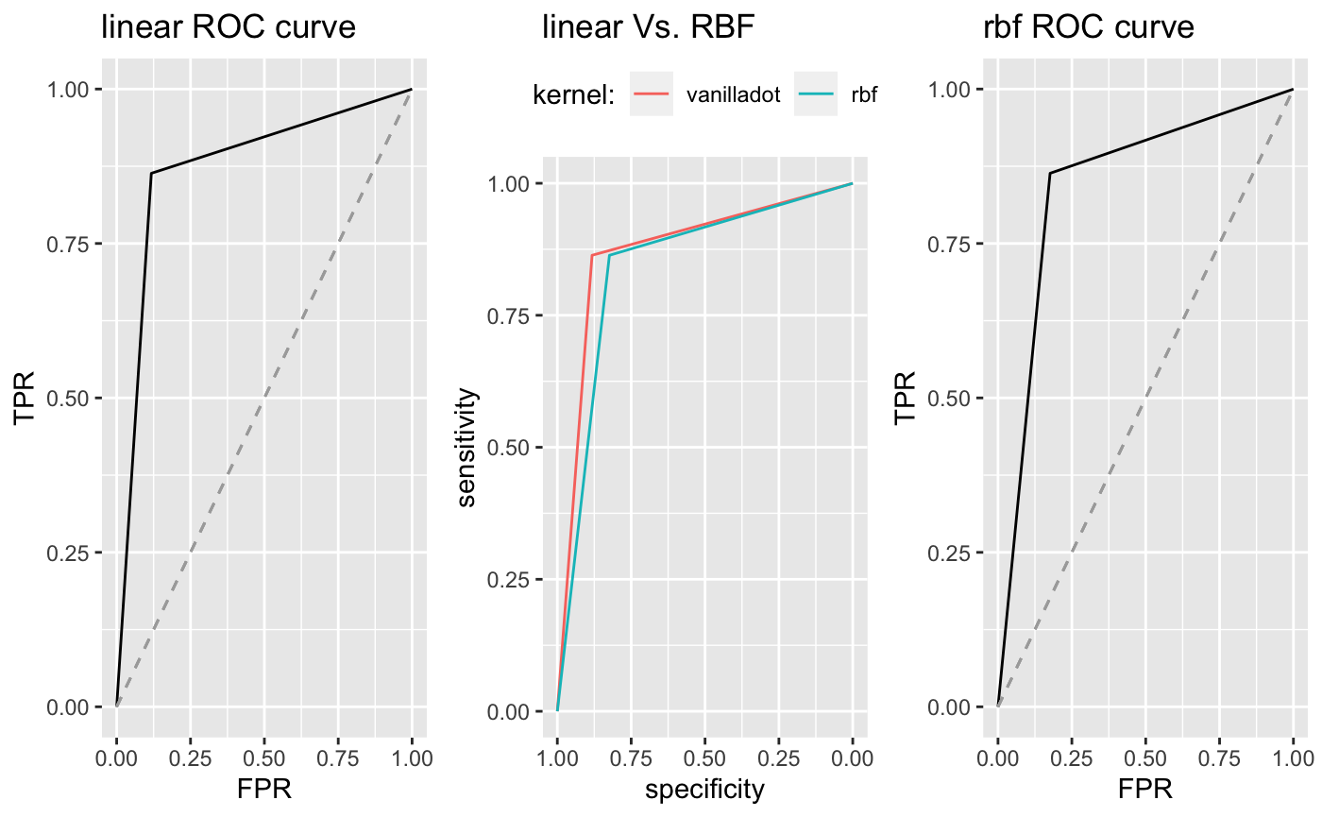
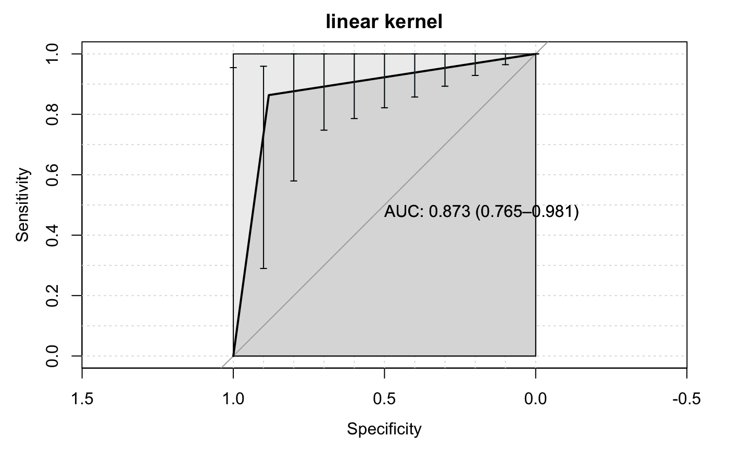
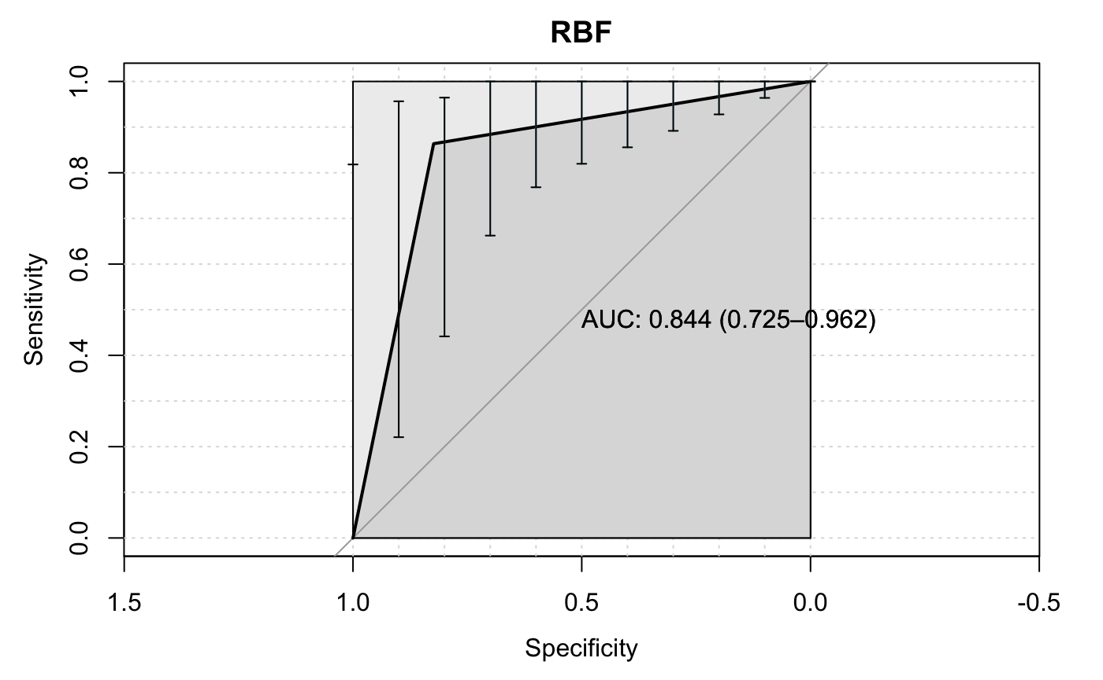
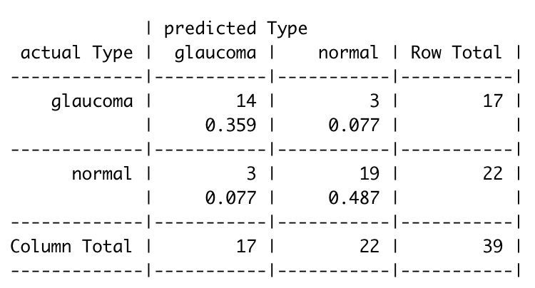
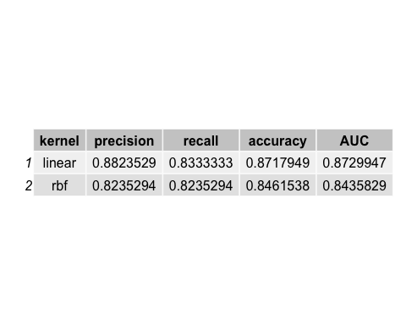
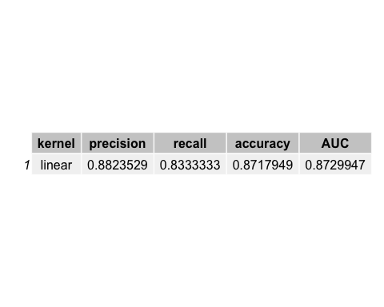
SVN
We started with the linear kernel (or “vanilladot” in R)

Slide 9
Future plans
Try to improve the recall (to minimize the FN), still with SVM
cost of constraints
Hyper-parameters
Classify with other algorithms
Random Forest
KNN
Decision Tree
Compare results of different classification algorithms
Notes:
Try to improve the recall (to minimize the FN), still with SVM
We want to improve our results, especially to minimize the false negatives- type II error- since we are working with information about patients, a result telling a person that might be sick that he is healthy can be much more problematic than a result telling a healthy person that he might be sick
cost of constraints: to “pay” a higher price for a FN than a FP
Hyper-parameters: such as “c” or “gamma”

